Slide 1
Shear Stresses in Transversely Loaded Beams

Slide 2

Shear Stresses in Beams
We will consider a beam with a distributed load in the neighbourhood of point C as shown
The transverse section of the beam at C and the coordinate system is shown in the picture on the right.
y
w (x)
z
C

Slide 3
Shear Stresses in Beams
Now we will consider another point D, very close to C.
Since the point is close to C, the nature of load, material properties and cross section will change very little.
y
w (x)
z
C
D

Slide 4
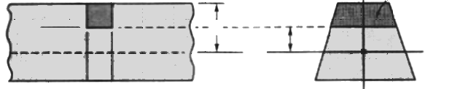
Shear Stresses in Beams
Next we take a magnified view of the beam around CD. Our x axis is positive from C to D.
The distance between C and D is Δx.
The neutral axis is at c from top
Neutral Axis
Δx
y
C
D
c
x
z

Slide 5
Shear Stresses in Beams
We now consider two points C’ and D’ right below C and D and at a distance y₁ from the neutral axis.
We will take this chunk out of the beam and see what forces act on it.
Neutral Axis
Δx
y
C
D
C’
D’
c
y₁
x
z

Slide 6
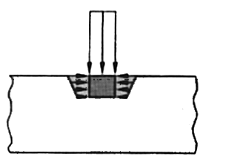
Shear Stresses in Beams
Here is how things look like when the chunk is still attached to the beam
We see a load wΔx acting vertically downward on the exposed surface CD
wΔx
C
D
C’
D’

Slide 7
Shear Stresses in Beams
We now remove the part of the beam attached to the bottom C’D’
We will now see the shear force DH which was holding the bottom of the chunk to the rest of the beam and preventing it from sliding in the process of bending.
The obvious question is what about vertical forces ?
We will answer that next.
wΔx
C
D
C’
D’
ΔH
H=Horizontal shear force

Slide 8
Shear Stresses in Beams
We now detach the side walls i.e. CC’ and DD’ from the beam.
Now the chunk is completely free of the beam
We get to see the vertical shear forces acting on the side walls.
These are the forces that were preventing the chunk from popping out of the beam while bending.
V_{C}
wΔx
V_{D}
C
D
C’
D’
ΔH
Vertical normal stresses are much smaller. So we are ignoring them. We have already encountered these vertical forces when drawing SFD for beams.

Slide 9
Shear Stresses in Beams
We also get to see the internal normal stresses that arise due to bending.
These are the stresses we have already encountered while studying bending of beams.
Since the external forces are downwards hence the beam will be compressed at the top. Hence the stresses are compressive.
wΔx
V_{C}
V_{D}
C
D
C’
D’
ΔH

Slide 10
Shear Stresses in Beams
The normal stresses on the walls CC’ and DD’ at any point a distance y from the neutral axis are given by
V_{C}
wΔx
V_{D}
C
D
y
C’
D’
y₁
ΔH
Neutral Axis

Slide 11
Shear Stresses in Beams
Hence the total force due to these stresses on the side walls up to a distance y is
V_{C}
wΔx
V_{D}
C
D
y
C’
D’
y₁
ΔH
Neutral Axis

Slide 12
Shear Stresses in Beams
Let us now do the force balance in the y direction.
Since Δx is small we can ignore change in area of cross section between C and D.
We get
V_{C}
wΔx
V_{D}
C
D
C’
D’
ΔH

Slide 13
Shear Stresses in Beams
We can now substitute for the stresses using the formula
If Δx is small then
wΔx
V_{C}
V_{D}
C
D
C’
D’
ΔH

Slide 14
Shear Stresses in Beams
We need to note some important points regarding how what we have done so far differs from what we usually do in our normal stress problem solving ?
First, we are not integrating over the entire cross section of the beam but from C’ to C.
But the I that we are using is for the entire cross section.
It is not the second moment of the area between C and C’ or D and D’.
This is because the formula for stress at any y uses the I for the entire cross section only. The I does not depend on y but on x.
If Δx is small then
V_{C}
wΔx
V_{D}
C
D
C’
D’
ΔH

Slide 15
Shear Stresses in Beams
Let us now recall a few points about moments and shear forces in beams.
We consider a section of the beam in the neighbourhood of C extending across the full depth of the beam.
The directions of the moments have been set such that the top part of the beam is in compression
The internal forces and moments change by ΔV and ΔM respectively as we shift by Δx.
wΔx
C
D
V
V+ΔV
M
M+ΔM
Δx

Slide 16
Shear Stresses in Beams
First we consider the equilibrium in y direction
wΔx
C
D
V
V+ΔV
M
M+ΔM
Δx

Slide 17
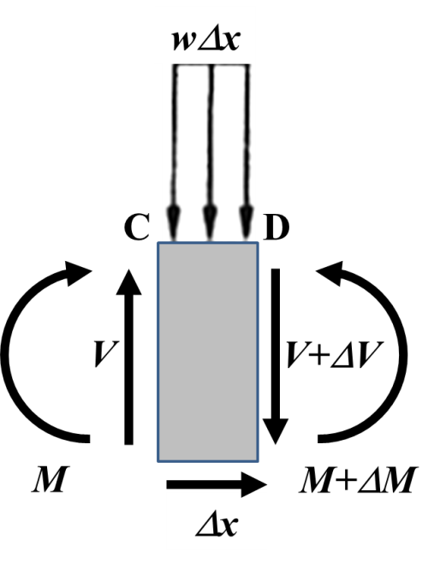
Shear Stresses in Beams
Next we consider moment equilibrium about C

Slide 18
Shear Stresses in Beams
In case of the present problem we have already obtained
If Δx is small then in the limit
wΔx
V_{C}
V_{D}
C
D
C’
D’
ΔH

Slide 19
Shear Stresses in Beams
We also know from our previous experience with SFD and BMD and our revision of bending in beams that
Hence
wΔx
V_{C}
V_{D}
C
D
C’
D’
ΔH

Slide 20
Shear Stresses in Beams
Let us try to understand this new quantity
Let us look at our initial diagrams of the beam. Q is the first moment of the dark shaded area in the second figure. Hence if that area is A_{a} and the centroid of that area has a y coordinate y_{a} then
y
y_{a}
Δx
Neutral Axis
C
D
C’
D’
c
y₁
x
z

Slide 21
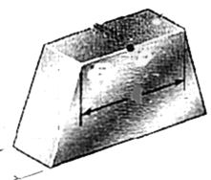
Shear Stresses in Beams
We can now define a quantity called shear flow by considering the width of the shaded area.
a
Δx
t
ΔH
t
y
t
Δx
C
D
C’
D’
c
y₁
Neutral Axis
x
z

Slide 22
Shear Stresses in Beams
The shear stress is simply ΔH divided by the area on which it is acting i.e. tΔx.
This should also answer the question why we call these vertical forces in beams as shear forces. They cause shear stress.
a
Δx
t
ΔH
t
y
t
Δx
C
D
C’
D’
c
y₁
Neutral Axis
x
z

